Slide 1
predictive modeling technique (function fitting or parametric modeling) - logistic regression By Jayanth Reddy Chintireddy DATA607

Slide 2
Logistic Regression
predictive modeling technique called function fitting or parametric modeling - logistic regression
Logistic regression applies linear models to class probability estimation

Slide 3
Linear model
linear model structure is a simple weighted sum of attribute values and data mining procedure fits the model to the data by finding the parameters/weights on these attributes
A general linear model:
X1, X2… - Attributes
w0, w1 ….- weights

Slide 4
Linear model
An objective function needs to be defined to calculate the weights.
This objective function should represent what we truly want to achieve in order to find best parameters. In other words should be a good proxy.

Slide 5
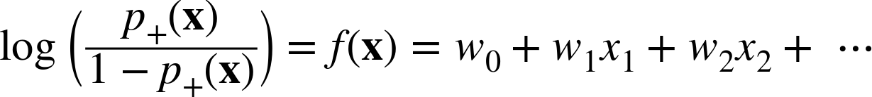
Log-odds linear function
Log-odds linear function:
- is the estimated probability of event occurring
- is the estimated probability of event not occurring
Odds are the probability of occurrence / non occurrence

Slide 6
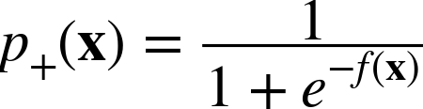
logistic function
logistic function also called sigmoid function because the result is an S shaped curve.
Using the log-odds linear function we can derive the logistic function
→
+ in probability is the binary event we are modeling

Slide 7
Use case – Basketball Probability of throw ending in basket
Taking the test data for training the model
shots = [1,1,1,1,1,1,0,1,0,1,1,0,0,1,1,0,0,0,1,0,0,0,0,0,1,0,0,0,0,0]
distance = [0,1,2,3,4,5,6,7,8,9,10,11,12,13,14,15,16,17,18,19,20,21,22,23,24,25,26,27,28,29] in feet
As seen 30 throws were attempted each from a different feet length
With this test data we will derive an equation to get probability of success

Slide 8
Use case – Basketball Probability of throw ending in basket
In this case the Linear function can be written as
F(x) = W0 + W1*distance
W0 is the predicted log-odds value when distance = 0
W1 is the slope
So, the logistic function can be written as
P(x) = 1 / [1 + e^(-f(x))]

Slide 9
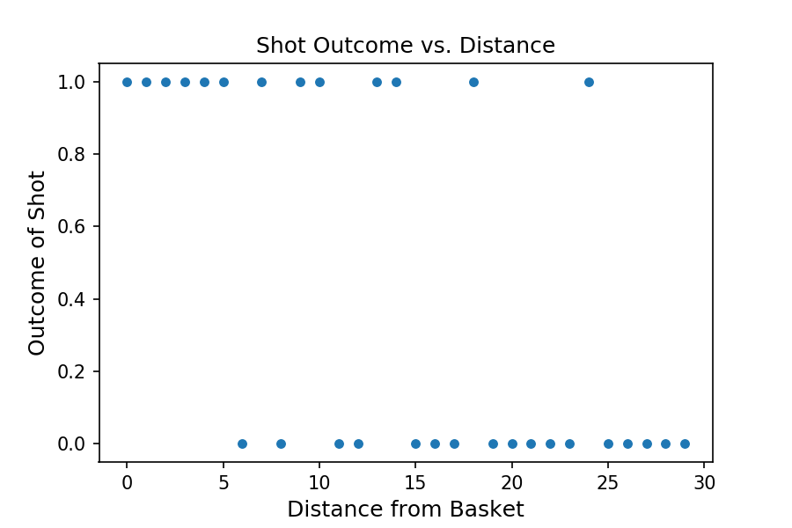
Use case – Basketball Probability of throw ending in basket
Scatter plot with training data

Slide 10
Use case – Basketball Probability of throw ending in basket
In order to calculate the probability, the linear function needs to be resolved and for that the weights need to be calculated.
Gradient descent optimization helps us to find the values of B0 and B1 that minimizes the total cost
Cost is the deviance from actual result
If Actual Outcome = 1, then Cost = -log(pred_prob)
Else if Actual Outcome = 0, then Cost = -log(1-pred_prob)
Total cost is the sum of costs calculated for each B0,B1 combination

Slide 11
Use case – Basketball Probability of throw ending in basket
Initial estimated parameters provided are B0 = 0.2 at 0 feet and B1 = -0.5
Using the Gradient descent optimization, we get the values B0 = 2.5 at 0 feet and B1 = -0.2
Examples for calculations of probability
e is the Euler’s constant = 2.718
At distance 0
F(x) = 2.5 + -0.2*0 = 2.5
P(x) = 1/[1+e^(-2.5)] = 0.92

Slide 12
At distance 5
F(x) = 2.5 + -0.2*5 = 1.5
P(x) = 1/[1+e^(-1.5)] = 0.82
At distance 15
F(x) = 2.5 + -0.2*15 = -0.5
P(x) = 1/[1+e^(0.5)] = 0.38
At distance 30
F(x) = 2.5 + -0.2*30 = -3.5
P(x) = 1/[1+e^(3.5)] = 0.03

Slide 13
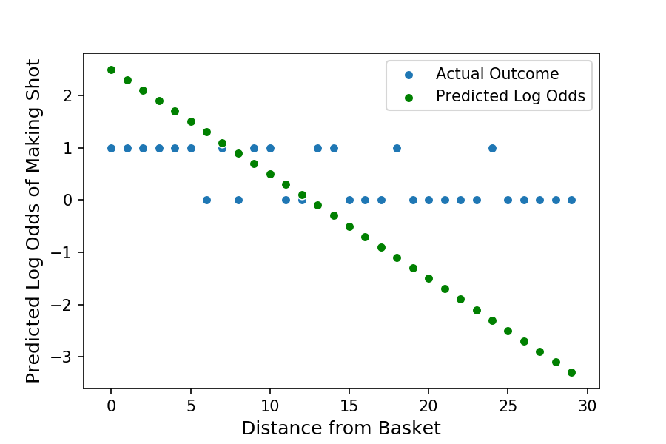
Use case – Basketball Probability of throw ending in basket
Predicted Log-odds depiction

Slide 14
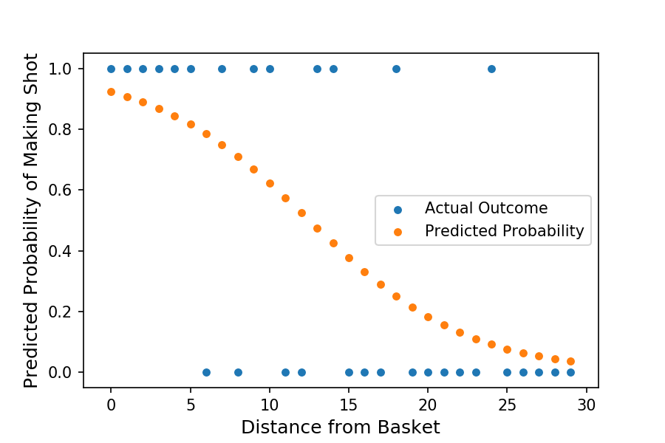
Use case – Basketball Probability of throw ending in basket
The final result is we get a sigmoid curve for predicted probability

Slide 15
References
Book
https://learning.oreilly.com/library/view/data-science-for/9781449374273/ch04.html
Use case data
https://towardsdatascience.com/understanding-logistic-regression-using-a-simple-example-163de52ea900

